Slide 1
Engineering Management Principles and Economics ENGR 301
Lecture 7- A
Annual Cash Flow Analysis
Dr C.J. Willis, CAPM. P.Eng
‹#›
Notes:
Last class we looked at present worth.
Here we look at annual cash flow analysis which is the second of three analysis techniques.
With present worth analysis we resolved an alternative into an equivalent cash sum at the present time
In annual cash flow analysis we compare alternatives based on their equivalent annual cash flows.
‹#›

Slide 2
Learning Objectives
Annual cash flow calculations
Annual worth analysis
Evaluation of Alternatives with:
Equal lives
Unequal lives
Continuous lives
Dr C.J. Willis, CAPM. P.Eng
‹#›

Slide 3
Annual Cash Flow
The objective is to compare alternatives based on annual cash flows.
This requires converting present values and one-time values on the timeline to equivalent uniform values.
Using annual worth factors:
For example: A = P(A/P, i%, 4)
A
0 1 2 3 4
P
Dr C.J. Willis, CAPM. P.Eng
‹#›
Notes:
‹#›

Slide 4
Annual Cash Flow Calculations
Example 1: A student bought $1,000 worth of home furniture. If it is expected to last 10years, what will the equivalent uniform annual cost be if interest is 7%?
0
1
2
3
4
5
6
7
8
9
10
0
=
A
A
A
A
A
A
A
A
A
A
P= 1,000
n = 10 years
i= 7%
Equivalent uniform annual cost = P(A/P,i,n)
= 1,000 (A/P, 7%, 10)
= 1,000 (0.1424)
= $142.40
Dr C.J. Willis, CAPM. P.Eng
‹#›
Notes:
In annual cash flow analysis we are using equivalency techniques to transform cash flows into’ annual cash flows’ as the basis of selecting an alternative
Here we see we can apply the capital recovery factor to convert the present value into an equivalent uniform cash flow.
‹#›

Slide 5
Annual Cash Flow Calculations - Salvage Value
When there is a salvage value at the end of the life of an asset, it is represented as a one-time cash flow benefit at the end of the asset’s life.
Example: Salvage value (S) of asset with a
4 year life
S
0 1 2 3 4
Dr C.J. Willis, CAPM. P.Eng
‹#›
Notes:
How do we treat salvage values?
The salvage value lowers the equivalent uniform annual cost
Salvage value is the market value of the asset at the end of its useful life.
‹#›

Slide 6
Annual Cash Flow Calculations - Salvage Value
When there is an initial cost (P) followed by a salvage value (S) the equivalent uniform annual cost (EUAC) can be computed by:
EUAC = P(A/P, i, n) – S(A/F, i, n)
OR
EUAC = (P – S)(A/F, i, n) + Pi
OR
EUAC = (P – S)(A/P, i, n) + Si
*EUAC calculated by the above equations is known as ‘Capital Recovery Cost’ of a project
Dr C.J. Willis, CAPM. P.Eng
‹#›
Notes:
There are three ways we can calculate the equivalent uniform annual cost when we have an initial cost followed by a salvage value.
We can convert both the present cost and salvage value into equivalent uniform annual costs and then find their difference. The conversion is done using the capital recovery factor and the sinking fund factor. This method reflects the annual cost of the cash disbursement minus the annual benefit of the future resale value
The second method computes the equivalent annual cost due to the unrecovered money when the investment (asset) is sold (P-S), and adds annual interest on the investment (asset) (+Pi)
The third method computes the annual cost of the decline in value of the unrecovered money (P-S) when the investment is sold, plus interest in the money tied up as salvage value. (+Si).
The first and third methods are most commonly used
‹#›

Slide 7
Annual Cash Flow Calculations (Salvage Value)
Example 2: The student in example 1 now believes the furniture can be sold at the end of 10 years for $200. Under these circumstances, what is the equivalent uniform annual cost?
S=$200
0
10
0
1
2
3
4
5
6
7
8
9
10
1
=
A
A
A
A
A
A
A
A
A
A
Dr C.J. Willis, CAPM. P.Eng
‹#›

Slide 8
Annual Cash Flow Calculations (Salvage Value Cont.)
Problem may be solved three ways:
Annual cost of the cash disbursements – the annual benefits of the future resale value
EUAC = P(A/P, i,n) – S(A/F, i, n)
= 1,000(A/P, 7%,10) – 200(A/F, 7%,10)
= 1,000(0.1424) – 200(0.0724)
= 142.4 – 14.48 = $127.92
Compute the equivalent annual cost due to the unrecovered $800 when the furniture is sold, and add annual interest on the $1,000 investment
EUAC = P(A/F,i,n) + Pi – S(A/F,i,n)
= (P-S)(A/F,i,n) + Pi
= (1,000-200)(A/F,7%,10) + 1000(0.007)
= 800(0.0724) + 70 = 57.92 + 70 = $127.92
Dr C.J. Willis, CAPM. P.Eng
‹#›
Notes:
EUAC is the present worth of cost adjusted by the capital recovery factor
Receipt of money decreases the EUAC (salvage value lowers the equivalent uniform annual cost)
‹#›

Slide 9
Annual Cash Flow Calculations (Salvage Value Cont.)
Compute the annual cost of the $800 decline in value during the 10 years + interest on the $200 tied up in the furniture as Salvage value.
EUAC = P(A/P,i,n) – S(A/P,i,n) + Si
= (P-S)(A/P, i,n) + Si
= (1,000 – 200)(A/P,7%,10) + 200(0.07)
= 800(0.1424) + 14 = 113.92 + 14 = $127.92
Dr C.J. Willis, CAPM. P.Eng
‹#›

Slide 10
EUAC Information
Direct relationship between present worth cost and equivalent uniform cost:
EUAC = PW Cost (A/P, i, n)
Expenditure of money increases EUAC
Receipt of money decreases EUAC
For irregular cash disbursements over the analysis period, it is convenient to convert them to a present worth cost first, then use the above equation to calculate the EUAC.
For arithmetic gradient, the EUAC may be computed by using the arithmetic uniform series factor
(A/G,i, n).
Dr C.J. Willis, CAPM. P.Eng
‹#›
Notes:
If equipment is replaced with equipment with identical economic consequences, then the annual cost of the first analysis period just repeats itself in the second multiple analysis period . This is highlighted in example 6-7
‹#›

Slide 11
Annual Cash Flow Analysis
Input or Output | Situation | Rule
Fixed input | Amount of money or other input resources is fixed | Maximize equivalent uniform annual benefits (maximize EUAB)
Fixed output | There is a fixed task, benefit, or other output to be accomplished | Minimize equivalent uniform annual cost (minimize EUAC)
Neither input nor output is fixed | Typical, general situation | Maximize equivalent uniform annual worth (EUAW = EUAB – EUAC)
Dr C.J. Willis, CAPM. P.Eng
‹#›
Notes:
For an alternative of a finite life in an infinite analysis period, we assume identical replacement. That is, the replacements have identical costs, performance etc. Because of this assumption, the same EUAC occurs for each replacement of the limited-life alternative. (refer to the example of replacing a pump)
When we have an alternative with an infinite life, the EUAC is the present value * annual interest + other annual costs
‹#›

Slide 12
Annual Cash Flow Analysis
A firm is considering which of two devices to install to reduce costs. Both devices have useful lives of 5 years with no salvage value. Device A cost $1000 and can be expected to result in $300 savings annually. Device B costs $1,350 and will provide cost savings of $300 the 1st year; however, savings will increase by $50 annually, making the2nd year savings $350, the third year savings $400, and so forth. With interest at 7%, which device should the firm purchase?
Device A: EUAW = -1000(A/P,7%,5) + 300
= -1000(0.2493) + 300 = $56.1
Device B: EUAW = -1,350 (A/P,7%,5) + 300 + 50 (A/G,7%,5)
= -1,350(0.2439) + 300 + 50(1.865) = $64
To maximize EUAW, choose device B
Dr C.J. Willis, CAPM. P.Eng
‹#›
Notes:
‹#›

Slide 13

Annual Cash Flow Analysis
Three alternatives are being considered for improving an operation on the assembly line along with the do nothing alternative. Equipment costs vary, as do the annual benefits of each in comparison to the present situation. Each of the plans: A, B and C has a 10-year life and a scrap value equal to 10% of its original cost. If interest is 8%, which plan, if any, should be adopted?
Dr C.J. Willis, CAPM. P.Eng
‹#›

Slide 14
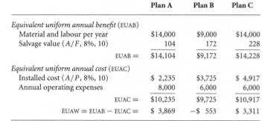
Annual Cash Flow Analysis
Solution: Since neither installed cost nor output benefits are fixed, the economic criterion is to maximize
EUAW = EUAB – EUAC
We should choose plan A. Do nothing is more desirable than plan B
Dr C.J. Willis, CAPM. P.Eng
‹#›

Slide 15
Types of Analysis Periods
Alternatives have equal lives.
If the lives are equal, the analysis period is based on the same lifetime .
Alternatives have unequal lives.
If the lives are unequal, the analysis period is based on alternate lifetimes.
No LCM is required as in present worth analysis
Multiples of service life are equivalent to one service life with annual worth analysis – therefore:
It doesn’t matter!
Dr C.J. Willis, CAPM. P.Eng
‹#›

Slide 16
Infinite Analysis Period
Since multiples of finite service lives are equivalent to one service life, an infinite analysis of finite service lives yield:
EUAC_{infinite analysis period}= EUAC_{for limited life n}
However, when an alternative with an infinite life is evaluated over an infinite analysis period:
EUAC_{infinite analysis period}= P(A/P, i, ∞) + Any other costs
When n = ∞, A = Pi, therefore:
EUAC_{infinite analysis period}= Pi + other Annual costs
Dr C.J. Willis, CAPM. P.Eng
‹#›

Slide 17
Infinite Analysis Period
Example: In the construction of an aqueduct to expand the water supply to a city, there are two alternatives for a particular portion of the aqueduct. Either a tunnel can be constructed through a mountain, or a pipeline can be laid to go around the mountain. If there is a permanent need for the aqueduct, should the tunnel or the pipeline be chosen for this particular portion of the aqueduct? Assume a 6% interest rate.
 | Tunnel through Mountain | Pipeline around Mountain
Initial Cost | $5.5 Million | $5 Million
Maintenance | 0 | 0
Useful Life | Permanent | 50 years
Salvage value | 0 | 0
Dr C.J. Willis, CAPM. P.Eng
‹#›

Slide 18
Infinite Analysis Period
Solution
For the tunnel, with its permanent life, we want (A/P,6%,∞). For an infinite life, the capital recovery is simply the interest on the invested capital.
(A/P,6%,∞) = i
EUAC = Pi = $5.5 million (0.06) = $330,000
Pipeline
EUAC = $5 million (A/P,6%,50)
= $5 million (0.0634) = $317,000
For fixed output, we want to minimize EUAC, therefore select the pipeline
Dr C.J. Willis, CAPM. P.Eng
‹#›

Slide 19
Infinite Analysis Period, cont’d.
The difference in annual cost between a long life and an infinite life is normally small, unless an unusually low interest rate is used.
Example: $5.5 Million cost at 6%/year
Infinite Life:
EUAC = 5.5(0.06) = $330,000
Long Life (85 years):
EUAC = 5.5(A/P, 6%, 85) = $332,000
Difference in time is large (85 compared to infinity) but the EUAC is small.
Dr C.J. Willis, CAPM. P.Eng
‹#›
Notes:
(A/P,i, ∞) = i
‹#›

Slide 20
Summary
Annual Cash Flow Analysis is the second of three major analysis techniques for alternative comparison.
When an alternative has cost P and salvage S:
EUAC = P(A/P, i, n) – S(A/F, i, n)
EUAC = (P – S)(A/F, i, n) + Pi
EUAC = (P – S)(A/P, i, n) + Si
All three equations give the same answer.
Dr C.J. Willis, CAPM. P.Eng
‹#›

Slide 21
Summary, cont’d.
Unlike present worth analysis, annual cash flow analysis does NOT require a common analysis period between the alternatives.
However two assumptions are included:
That the actual values of future instances of a service are the same as the current instance
There is a common multiple of useful lives between the alternatives
As the value of n increases the capital recovery factor approaches i (Interest Rate).
Dr C.J. Willis, CAPM. P.Eng
‹#›

Slide 22
Engineering Management Principles and Economics ENGR301
Lecture 7-B
Rate of Return Analysis
Dr C.J. Willis, CAPM. P.Eng
‹#›

Slide 23
Rate of Return
Rate of Return or Internal Rate of Return is a 3rd major analysis method (Present Worth & Annual Cash Flow Analysis)
Rate of Return analysis is widely used in industry.
It provides a measure of a project’s desirability in terms that are easily understood.
Net present worth on the project is $32,000
Equivalent uniform annual net benefit is $2,800
The project will produce 23% rate of return
Decisions to proceed are often based on the comparison to a:
Minimum Attractive Rate of Return (MARR)
Dr C.J. Willis, CAPM. P.Eng
‹#›
Notes:
We know the present value is $1000
We apply the capital recovery factor to the present value to determine the equivalent uniform annual cost
‹#›

Slide 24
Rate of Return
IRR is defined as that interest rate which equates the sum of the present value of cash inflows with the sum of the present value of cash outflows for a project.
In general, the calculation procedure for IRR involves a trial-and-error approach
Dr C.J. Willis, CAPM. P.Eng
‹#›

Slide 25
Internal Rate of Return (IRR)
A project’s rate of return defined by:
the interest rate at which the present worth and equivalent uniform annual worth are equal to zero.
This is the interest rate where:
benefits are equivalent to the costs.
Dr C.J. Willis, CAPM. P.Eng
‹#›

Slide 26
IRR Calculation
Given a cash flow, there are five forms of equations that can be used to solve for the unknown interest rate:
PW of benefits – PW of costs = 0
PW of benefits/PW of costs = 1
Present worth = Net present worth = 0
EUAW = EUAB – EUAC = 0
PW of costs = PW of benefits
These are the same concepts in five different forms.
Dr C.J. Willis, CAPM. P.Eng
‹#›
Notes:
In method 1 we apply the capital recovery factor and the sinking fund factor
Pi represents the present value and the interest gained on the present value annually
‹#›

Slide 27
IRR Calculation
Steps to determine IRR for a single stand-alone investment
Step 1: Take the dollar amounts to the same point in time using the compound interest formulas
Step 2: Equate the sum of the revenues to the sum of the costs at that point in time and solve for i
Dr C.J. Willis, CAPM. P.Eng
‹#›

Slide 28
IRR (Example 1)
An engineer invests $5000 at the end of every year during a 40-year career. If the engineer wants $1 million in savings at retirement, what interest rate must the investment earn?
To find the IRR, we set the Net PW = 0
NPW = 0 = -$5000(F/A,i, 40) + $1,000,000
Rearranging,
(F/A,i,40) = $1,000,000/$5,000 = 200
Looking at the compound interest tables for the value of i where (F/A,i,40) = 200.
We see (F/A,0.07,40) = 199.636 ≈ 200
Therefore, IRR = 7%
Dr C.J. Willis, CAPM. P.Eng
‹#›

Slide 29
IRR (Example 2)
An investment resulted in the following cash flow. Compute the rate of return.
Year | Cash Flow
0 | -$700
1 | +100
2 | +175
3 | +250
4 | +325
Dr C.J. Willis, CAPM. P.Eng
‹#›
Notes:
The rules for economic efficiency apply to annual cash flow analysis.
For fixed input we want to maximize equivalent uniform annual benefits. This is the same in PW when we seek to maximize present worth of benefits
‹#›

Slide 30
IRR (Example 2)
Since we are provided with a uniform annual cash flow, we use EUAB – EUAC = 0
100 + 75(A/G,i,4) – 700(A/P,i,4) = 0
Because we have two different interest factors we have to solve by trial and error.
When i=5%
EUAB – EUAC = 0
100+75(A/G,5%,4) – 700(A/P,5%,4) =0
100+75(1.439)-700(0.2820)=0
EUAB-EUAC=208-197=+11
Dr C.J. Willis, CAPM. P.Eng
‹#›
Notes:
In this situation neither input nor output is fixed. We analyze this situation using EUAW
For device A we know the present cost which we convert to an equivalent uniform annual cash flow by applying the capital recovery factor
We know the equivalent uniform benefit is $300
For device B the annual benefit increases by an arithmetic gradient. We apply the gradient uniform series factor to make it into an equivalent uniform annual amount.
We choose the alternative with the higher EUAW
‹#›

Slide 31
IRR (Example 2)
The EUAC is too low, so we try i=8%
EUAB-EUAC=0
100+75(A/G,8%,4)-700(A/P,8%,4)=0
100+75(1.404)-700(0.3019)=0
EUAB-EUAC=205-211=-6 (EUAC is too large)
Rate of return must be between 5% and 8%
Try i=7%
EUAB-EUAC=0
100+75(A/G,7%,4)-700(A/P,7%,4)=0
100+75(1.416)-700(0.2952)=0
EUAB-EUAC=206-206=0
IRR = 7%
Dr C.J. Willis, CAPM. P.Eng
‹#›
Notes:
Here again we have a situation where neither input nor output is fixed. We choose based on the EUAW
‹#›

Slide 32
IRR (Example 3)
A local firm sponsors a student loan program for the children of its employees. No interest is charged until graduation, and then the interest is 5%. Maria borrows $9000 per year, and she graduates after four years. Since tuition must be paid ahead of time, assume that she borrows the money at the start of each year. If Maria makes five annual payments, what is each payment? Calculate the IRR for Maria’s loan.
Dr C.J. Willis, CAPM. P.Eng
‹#›

Slide 33
IRR (Example 3)
Loan payment = $36,000(A/P,5%,5)=36000(0.231)=$8,316
Maria receives $9000 by borrowing at the start of each year. Since she graduates at the end of year 4, which is the beginning of year 5, interest starts to accrue. She makes her first payment at the end of year 5, which is one year after graduation
PW(i) = 9,000[1+(P/A,i,3)]-8,316(P/A,i,5)(P/F,i,4)
Try i=0% PW(0%)=9,000*4-8,316*5 = -5,580
Try i=3% PW(3%) =9,000*(1+2.829)-8,316*4.58*0.8885=620.5
Since the PW has opposite signs between 0 and 3%, the IRR lies between 0% and 3%
Year | 0 | 1 | 2 | 3 | 4 | 5 | 6 | 7 | 8 | 9
Cash Flow | 9,000 | 9,000 | 9,000 | 9,000 | 0 | -$8,316 | -$8,316 | -$8,316 | -$8,316 | -$8,316
Dr C.J. Willis, CAPM. P.Eng
‹#›
Notes:
We make the salvage value into a uniform amount by adjusting it by the sinking fund factor.
We make the installed costs into a uniform amount by adjusting it by the capital recovery factor
For plan B, the EUAC exceeds the EUAB, hence its EUAW is negative
‹#›

Slide 34
IRR (Example 3)
Try i=2%
PW(2%)=9,000+(1+2.884)-8,316*4.713*0.9238=-1,251
We interpolate between 2% and 3%, finding IRR to be 2.67%
IRR=2%+(3%-2%)[1,251/(1,,251+620.80]=2.67%
The alternative to interpolating would be to plot a graph of i versus NPW. The IRR is the point at which the graph intersects the x axis, i.e. when NPW=0
Dr C.J. Willis, CAPM. P.Eng
‹#›

Slide 35
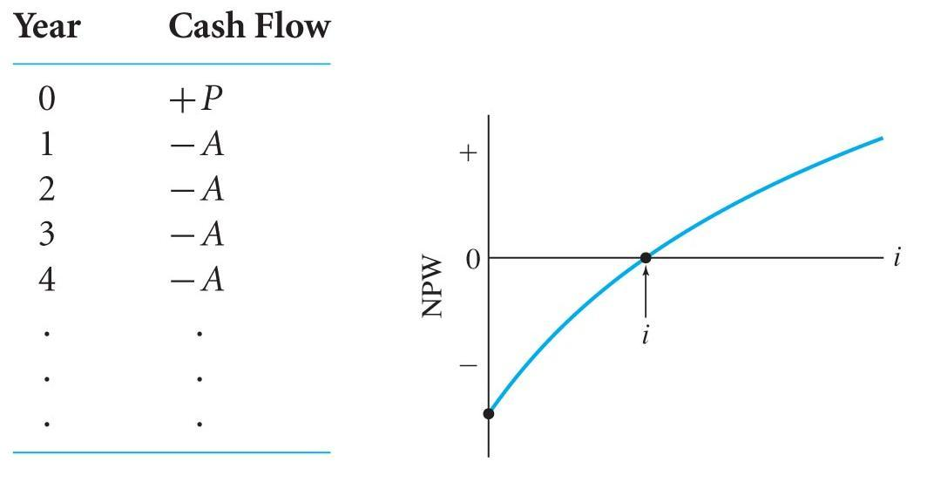
NPW versus Interest Rate
A typical plot for borrowed money:
Viewpoint of the borrower:
The IRR is located where the plot crosses the NPW = 0 point.
Dr C.J. Willis, CAPM. P.Eng
‹#›
Notes:
What is the decision criteria?
Minimize EUAC when output is fixed
‹#›

Slide 36
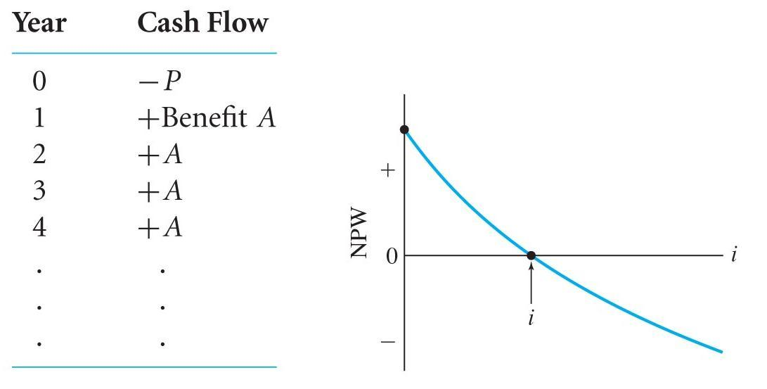
NPW versus Interest Rate, cont’d.
A typical plot for invested money:
Viewpoint of the investor:
The IRR is where the plot crosses the NPW = 0 point.
Dr C.J. Willis, CAPM. P.Eng
‹#›

Slide 37
Incremental Analysis
In rate of return analysis, two or more alternatives are compared using the incremental rate of return (ΔIRR) on the difference between the alternatives.
The project increment is ordered by:
Higher initial cost project – Lower initial cost project = Increment
The new cash flow created from the cash flow increments is evaluated.
The ΔIRR of the new cash flow is determined.
Dr C.J. Willis, CAPM. P.Eng
‹#›

Slide 38
Incremental Analysis
The decision is then based on the MARR:
If ΔIRR >= MARR choose the higher initial cost alternative.
This indicates that the additional cost is justified.
If ΔIRR < MARR choose the lower initial cost alternative.
This indicates that the additional cost is NOT justified.
The opposite is true if the viewpoint is from the borrowing perspective instead of the investment perspective.
Dr C.J. Willis, CAPM. P.Eng
‹#›

Slide 39
IRR (Example 4)
A firm is considering which of two devices to install to reduce costs. Both devices have useful lives of five years and no salvage value. Device A costs $1000 and can be expected to result in $300 in savings annually. Device B costs $1300 and will provide cost savings of $300 the first year but savings will increase $50 annually, making the second-year savings $350, the third-year savings $400, and so forth. For a 7% MARR, which device should the firm purchase?
Dr C.J. Willis, CAPM. P.Eng
‹#›
Notes:
MARR also known as minimum acceptable rate of return and hurdle rate is the rate of return on a project a manager or company is willing to accept before starting a project, given its risk and the opportunity cost of forgoing other projects.
MARR is based on Opportunity Costs, Transaction Costs, Compensate for Risk, Cover anticipated Inflation
‹#›

Slide 40
IRR (Example 4)
Year | Device A | Device B | Device B – Device A
0 | -$1000 | -$1350 | -$350
1 | +300 | +300 | 0
2 | +300 | +350 | +50
3 | +300 | +400 | +100
4 | +300 | +450 | +150
5 | +300 | +500 | +200
IRR is found when the Present Worth of the difference between alternatives is Zero
PW(i) = 0 = -350 + 50(P/G,i,5)
(P/G,i,5) = 7, so i is between 9% (P/G,9%,5)=7.111 and 10% (P/G,10%,5)=6.862
Interpolating: i= 9%+(10%-9%)(7.111-7)/(7.11-6.862)=9.45%
Since our incremental IRR > MARR, choose the alternative with the higher initial cost.
Choose device B
Dr C.J. Willis, CAPM. P.Eng
‹#›
Notes:
It is the interest rate at which the present value of benefits equals the present value of costs
‹#›

Slide 41
IRR Caution
Internal Rate of Return can be deceiving.
Comparing projects strictly on the IRR of each project can provide incorrect results and disagree with present worth or annual worth analysis.
This is why we use the ΔIRR.
The objective is to maximize the ‘return’ NOT the ‘rate of return’.
The analysis period needs to be the same as we are examining the increments between alternatives
Note: Projects can include the ‘do-nothing’ alternative if the selection of an alternative is not ‘required’.
Dr C.J. Willis, CAPM. P.Eng
‹#›

Slide 42
Summary
Internal Rate of Return (IRR) is the interest rate at which the present worth and equivalent uniform annual worth are equal to zero.
E.g., NPW = 0
Alternatives are chosen through incremental rate of return analysis.
Selection based on the IRR of each project does NOT provide consistent results with present worth or annual worth analysis.
Dr C.J. Willis, CAPM. P.Eng
‹#›

